Slide 1

https://sahibulsaif.wordpress.com/wisdom/bismillah-nature/

Slide 2
Database types & development life cycle
CSC271 – DATABASE SYSTEMS
LECTURE - 04

Slide 3
Previous Lecture Overview

Slide 4
Today’s Lecture
In this lecture, you will learn about:
Types of Database systems
Database development life cycle

Slide 5
Database types based on Location
Centralized database:
A database that supports data located at a single site is called a centralized database
Distributed database:
A database that supports data distributed across several different sites is called a distributed database

Slide 6
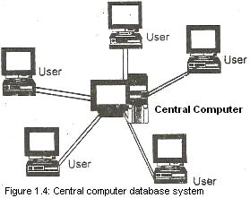
Centralized Database
If a database is located at a single location and different users at different places access the database from that single location, then it is known as Centralized Database.

Slide 7
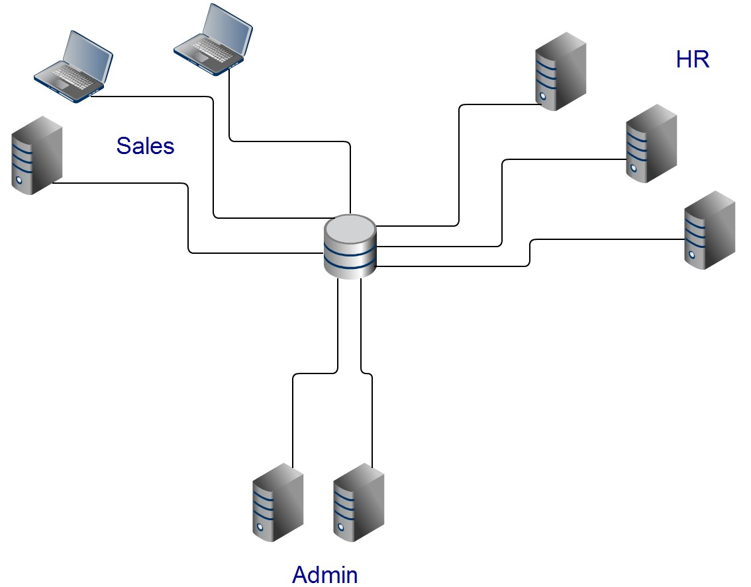
Centralized Database
+ Easier to organise, edit, query and backup
- Can be slower because of high usage / load

Slide 8
Distributed Database
A distributed database is a single logical database, which is spread physically across multiple computers (called database servers) over wide area network
Such databases are managed by the organizations having offices in different cities or countries
Any user at any office can access data of his office as well as of other offices
because of mutual communication between database servers at all offices

Slide 9
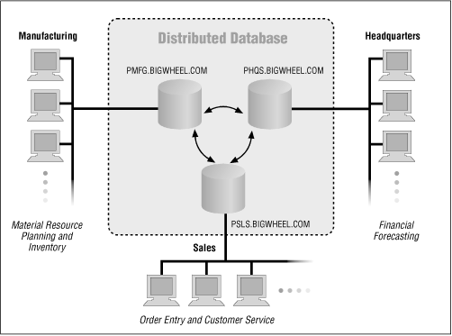
Distributed Database

Slide 10
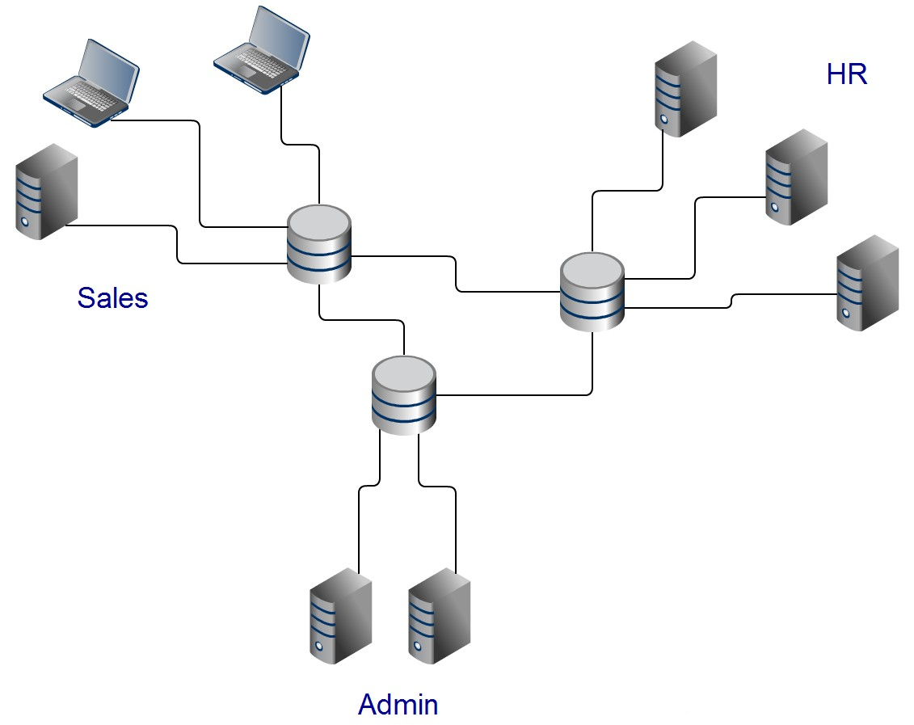
Distributed Database
+ Data access and retrieval faster at nearest points
- Can be slower accessing non local data
- Need to be ensure data is consistent / synchronised

Slide 11
Distributed Database
Homogeneous Database
all nodes use the same hardware, software (OS & DBMS) and data structures for the database system
Heterogeneous Database
different nodes may have different hardware & software (OS & DBMS) and data structures at various nodes or locations are also incompatible

Slide 12
Database types based on Usage
Operational database:
A database that is designed primarily to support a company’s day-to-day operations is classified as an operational database
aka Transactional or Production database
Data warehouse:
Integrated decision support system derived from various operational databases on periodic basis
A data warehouse focuses primarily on storing data used to generate information required to make tactical or strategic decisions like to formulate pricing decisions, sales forecasts, market positioning, and so on.

Slide 13
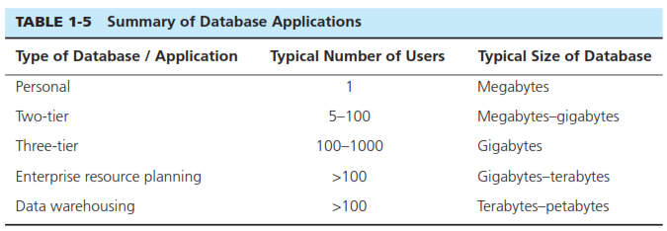
Database types based on Storage size & No. of Users

Slide 14
Database Development

Slide 15
Two Approaches to Database Development
SDLC
System Development Life Cycle
Traditional methodology used to develop, maintain, and replace information systems
Detailed, well-planned development process
Time-consuming, but comprehensive
Long development cycle

Slide 16
Two Approaches to Database Development
Prototyping
Rapid application development (RAD)
Cursory attempt at conceptual data modeling
Define database during development of initial prototype
Repeat implementation and maintenance activities with new prototype versions

Slide 17
Database Development Life Cycle
Planning
Analysis
Logical Design
Physical Design
Implementation
Maintenance
Notes:
SDLC is a complete set of steps that a team of information systems professionals, including database designers and programmers, follow in an organization to specify, develop, maintain, and replace information systems.

Slide 18
Database Development Life Cycle
Planning
Purpose–preliminary understanding
Deliverable–request for study
Analysis
Logical Design
Physical Design
Implementation
Maintenance
Database activity–
enterprise modeling and early conceptual data modeling
Notes:
Enterprise Modelling:
-review current databases and information systems
-analyze the nature of the business area that is the subject of the development project
-describe, in very general terms, the data needed for each information system under consideration for development.
Early Conceptual Data Modelling:
-outline the scope of data involved in this particular development project
-Mention high level entities and major relationships

Slide 19
Database Development Life Cycle
Planning
Purpose–thorough requirements analysis and structuring
Deliverable–functional system specifications
Analysis
Logical Design
Physical Design
Implementation
Maintenance
Database activity–Thorough and integrated conceptual data modeling
Notes:
-detailed data model identifying all the organizational data to be managed (attribute, entities, relationships, constraints)

Slide 20
Database Development Life Cycle
Planning
Purpose–information requirements elicitation and structure
Deliverable–detailed design specifications
Analysis
Logical Design
Logical Design
Physical Design
Implementation
Maintenance
Database activity–
logical database design (transactions, forms, displays, views, data integrity and security)
Notes:
Elicitation: practice of collecting requirements from users, customers and stakeholders.
conceptual schema must be transformed into a logical schema (technology dependent e.g. relational)
Results in complete picture of database without reference to a particular DBMS

Slide 21
Database Development Life Cycle
Planning
Purpose–develop technology and organizational specifications
Deliverable–program/data structures, technology purchases, organization redesigns
Analysis
Logical Design
Physical Design
Physical Design
Implementation
Maintenance
Database activity–
physical database design (define database to DBMS, physical data organization, database processing programs)
Notes:
How data from a logical schema are stored in a computer’s secondary memory by a specific database management system
analyst decides on the organization of physical records

Slide 22
Database Development Life Cycle
Planning
Purpose–programming, testing, training, installation, documenting
Deliverable–operational programs, documentation, training materials
Analysis
Logical Design
Physical Design
Implementation
Implementation
Maintenance
Database activity–
database implementation, including coded programs, documentation, installation and conversion
Notes:
designer writes, tests, and installs the programs/scripts that access, create, or modify the database
finalize all database documentation, train users
load data from existing information sources (files and databases from legacy applications plus new data now needed)

Slide 23
Database Development Life Cycle
Planning
Purpose–monitor, repair, enhance
Deliverable–periodic audits
Analysis
Logical Design
Physical Design
Implementation
Maintenance
Maintenance
Database activity–
database maintenance, performance analysis and tuning, error corrections
Notes:
the designer adds, deletes, or changes characteristics of the structure of a database in order to meet changing business conditions, to correct errors

Slide 24
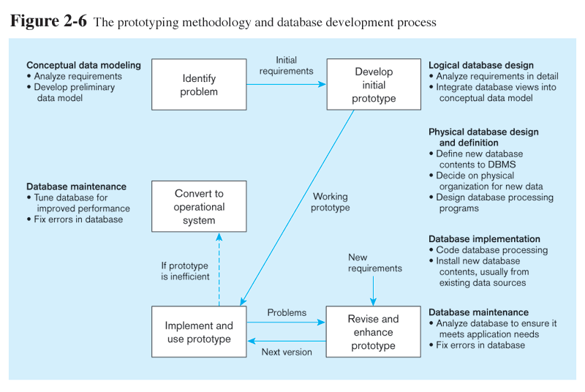
Database Development - Prototyping
Notes:
SDLC is criticized for the length of time needed until a working system is produced, which occurs only at the end of the process

Slide 25
Database Development - Prototyping

Slide 26
Database Development - Prototyping

Slide 27
Database Development - Prototyping

Slide 28
Database Development - Prototyping

Slide 29

http://www.thomasformo.com/category/qa/

